Slide 1
The final
Moscow coffee houses
Kirill Mokhniuk
March, 2021

Slide 2
Introduction
In this work I want to analyze amount of coffee houses per capita in different Moscow boroughs. I believe that it will be interesting for entrepreneurs who want to start own coffee house in Moscow, but don’t know where there will be fewer competitors.

Slide 3
Data
For the work I need two parts of data.
1. Data about name, size, population, longitude, and latitude of Moscow boroughs.
2. Data about amount of coffee houses in every Moscow borough.

Slide 4
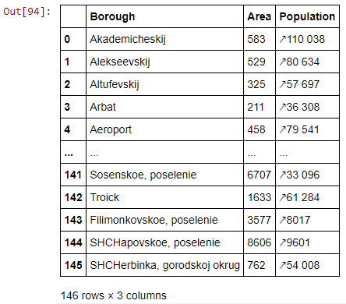
Methodology
First of all I scrapped data about Moscow boroughs from Wikipedia article (it is in Russian, but I translated data to English). Then clean it and receive a dataframe:

Slide 5
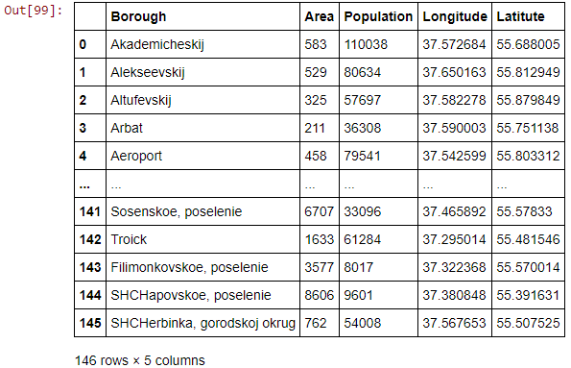
Methodology
Then I used Yandex API (it is a good choice for Russia) for longitude and latitude for every borough, and added it to the dataframe:

Slide 6
Methodology
Next step is receiving data about coffee houses in Moscow. I had a problem: different boroughs have different size of area, and I did know which radius I should choose for Foursquare API, but I had size of area! So I decided to consider each borough as a circle, and found radius for every borough. Yes, it is not very accurate. So after that I parsed data from Foursquare about venues in these boroughs.

Slide 7
Results
Unfortunately I had fatal problem. Foursquare hasn’t a lot data about Moscow venues, and it is impossible to use it for good analysis. So at the final step I received this dataframe:

Slide 8
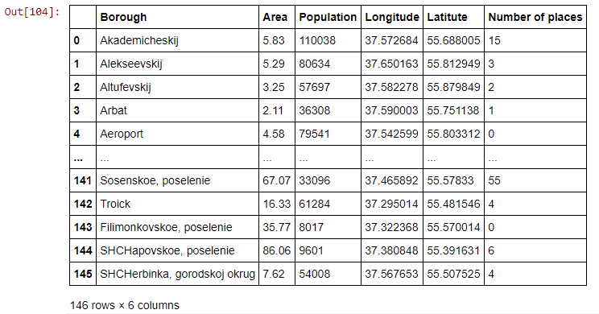
Results

Slide 9
Results
For example, Foursquare has data just about 15 venues in Akademicheskij borough, and it is not only coffee houses, it is different types of venues: pharmacies, restaurants etc. It is impossible, because Akademicheskij borough is pretty close to city center, so in real life there are hundreds of venues there.

Slide 10
Discussion
This work shows us that Foursquare not very popular in Moscow (and I guess in Russia at all) and people don’t add info about venues to Foursquare database, but if we choose other city, for example NY or Paris, where Foursquare has more data, we can do this analysis.

Slide 11
Conclusion
Unfortunately, I didn’t reach the goal of this work: didn’t find out amount per capita of coffee houses in Moscow boroughs. But negative result is still result, and I believe that this work has some value. Additionally, I used all skills from the specialization and showed you, that I can handle with data.
Thanks for reading, and have a nice day!

